Slide 1
Staying in the Know:
Insight into the Unique Alcohol Laws in Texas
with
&
July 2018
This document contains confidential information conveyed by fintech.net. Any dissemination, distribution, copying, or misrepresentation of the contents of this document is strictly prohibited.

Slide 2
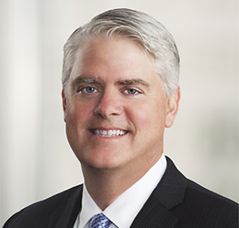
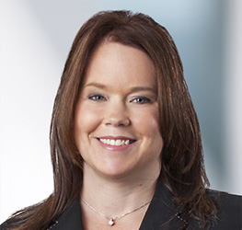
Presenters
Dewey Brackin Catherine Chamblee
*** NOTE: This presentation is a compilation of information gathered from official state resources and is intended to be educational in nature. It is NOT intended to be legal advice.
As well, the information contained in this presentation is subject to change at any time.
All information should be validated with your local resources, as local ordinances are a significant factor in Texas regulations.

Slide 3
Agenda
History of Alcohol Prohibition and Repeal
3-tier System
How to Identify Your State Agency and Resources
Minimum Age to Serve/Sell Alcohol
Gaming and Contests
Product Integrity and Tax Stamps
Guidelines for Advertising Drink Prices
Accepting Advertising from other Industry Members
Limitations on Offering Drink Specials
Payment Terms
Delivery
Returning Alcohol to Your Suppliers
Recordkeeping
Reporting Officer and Director Changes
Safe Harbor
This document contains confidential information conveyed by fintech.net. Any dissemination, distribution, copying, or misrepresentation of the contents of this document is strictly prohibited.

Slide 4
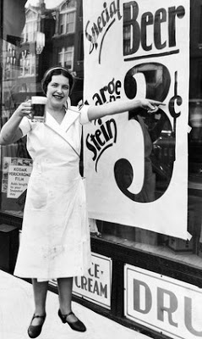
Alcohol In The Early Days
In the early 1900s……
Manufacturers were giving massive discounts to bars in return for exclusivity. This practice tied the retailers to the manufacturers in many ways.
Bars were passing the discounts to consumers. Alcohol was CHEAP and plentiful!!
This document contains confidential information conveyed by fintech.net. Any dissemination, distribution, copying, or misrepresentation of the contents of this document is strictly prohibited.

Slide 5
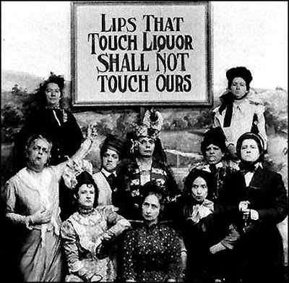
Prohibition and Repeal
Excessive consumption and drunkenness was conflicting with social and personal welfare.
In 1920 alcohol was prohibited by the Federal Government.
In 1933 the prohibition was lifted.
….. but each state was tasked with making their own rules to regulate alcohol, and manufacturers and retailers had to be kept arms-length from each other
This document contains confidential information conveyed by fintech.net. Any dissemination, distribution, copying, or misrepresentation of the contents of this document is strictly prohibited.

Slide 6
3 Tier System
Breweries, Wineries, Distilleries
X
NEW TIER!!
Distributors
Hotels, Restaurants, Grocery Stores
This document contains confidential information conveyed by fintech.net. Any dissemination, distribution, copying, or misrepresentation of the contents of this document is strictly prohibited.

Slide 7
Who’s In Charge?
Federal Oversight of Suppliers and Wholesalers TTB (Alcohol and Tobacco Tax and Trade Bureau)
Which state agency is in charge ….?
TABC: Texas Alcoholic Beverage Commission
Who’s in charge of the state agency ….?
Chairman - Kevin Lilly
Commissioner - Ida Clement Steen
- 1 vacancy
Executive Director - Adrian Nettles
Deputy Executive Director - Matt Chaplin
General Counsel - Clark Smith
What’s the website address ….?
http://www.tabc.texas.gov/index.asp
This document contains confidential information conveyed by fintech.net. Any dissemination, distribution, copying, or misrepresentation of the contents of this document is strictly prohibited.

Slide 8
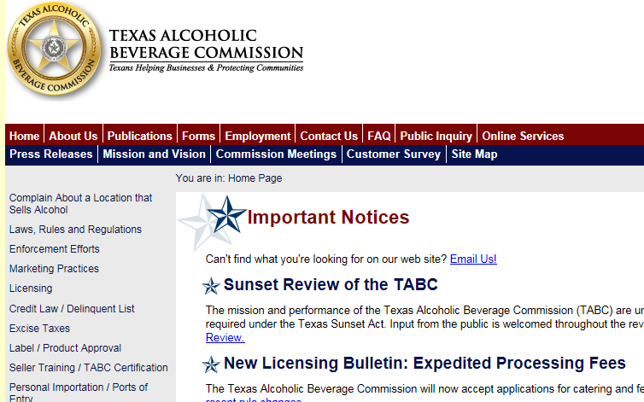
Where Can I Find The Rules?
Statutes: https://www.tabc.state.tx.us/laws/code/85th/AllTitles.pdf
Rules: https://www.tabc.state.tx.us/laws/other/TABCRules.pdf
This document contains confidential information conveyed by fintech.net. Any dissemination, distribution, copying, or misrepresentation of the contents of this document is strictly prohibited.

Slide 9
Minimum Ages
Sec. 106.09. EMPLOYMENT OF MINORS. (a) Except as provided by Subsections (b), (c), (e) and (f), no person may employ a person under 18 years of age to sell, prepare, serve, or otherwise handle liquor, or to assist in doing so.
(b) A holder of a wine only package store permit may employ a person 16 years old or older to work in any capacity.
(c) A holder of a permit or license providing for the on-premises consumption of alcoholic beverages may employ a person under 18 years of age to work in any capacity other than the actual selling, preparing, or serving of alcoholic beverages.
(e) The holder of a permit or license providing for the on-premises consumption of alcoholic beverages who also holds a food and beverage certificate may employ a person under 18 years of age to work as a cashier for transactions involving the sale of alcoholic beverages if the alcoholic beverages are served by a person 18 years of age or older.
(f) The holder of a permit or license providing for the on-premises consumption of alcoholic beverages that derives less than 50 percent of its gross receipts for the premises from the sale or service of alcoholic beverages may employ a person under 18 years of age to work as a cashier for transactions involving the sale of alcoholic beverages if the alcoholic beverages are served by a person 18 years of age or older.
This document contains confidential information conveyed by fintech.net. Any dissemination, distribution, copying, or misrepresentation of the contents of this document is strictly prohibited.

Slide 10
Serving Minors at On-Premise Locations
WI
WY
CT
NV
OH
MS* - beer only (not exceeding 5% ABW)
MS*
TX
LA
This document contains confidential information conveyed by fintech.net. Any dissemination, distribution, copying, or misrepresentation of the contents of this document is strictly prohibited.
Permissable to serve minors:
LA
Parents must be present and consent
Parents must be present and consent AND minor must be at least 18 years old

Slide 11
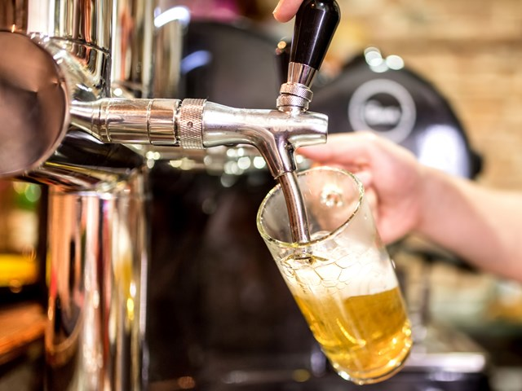
Serving Minors in Texas
Sec. 106.04. CONSUMPTION OF ALCOHOL BY A MINOR.
(b) It is an affirmative defense to prosecution under this section that the
alcoholic beverage was consumed in the visible presence of the minor’s
adult parent, guardian, or spouse.
Sec. 106.06. PURCHASE OF ALCOHOL FOR A MINOR
(b) A person may purchase an alcoholic beverage for or give an alcoholic
beverage to a minor if the person is:
(1) the minor's adult parent, guardian, or spouse, or an adult in whose custody the minor has been committed by a court, and is visibly
present when the minor possesses or consumes the alcoholic
beverage
Note: This allowance does NOT
permit sales to a minor
This document contains confidential information conveyed by fintech.net. Any dissemination, distribution, copying, or misrepresentation of the contents of this document is strictly prohibited.

Slide 12
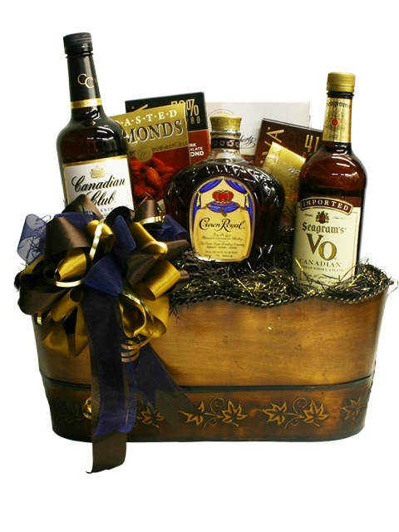
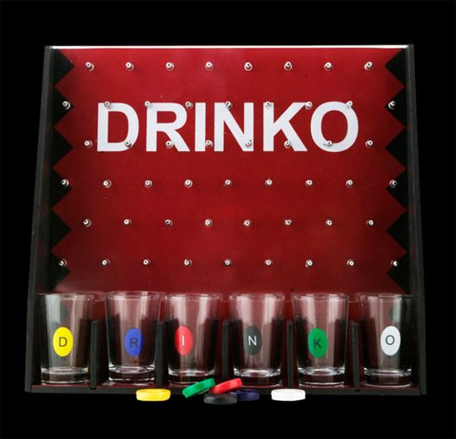
Gaming and Contests
Rule 45.103 (c) Licensees and permittees authorized to sell or serve alcoholic beverages for on-premises consumption may not:
(10) conduct, sponsor or participate in, or allow any person on the licensed premises to conduct, sponsor or participate in, any game or contest to be determined by the quantity of alcoholic beverages consumed by an individual or group, or where alcoholic beverages or reduced price alcoholic beverages are awarded as prizes.
This document contains confidential information conveyed by fintech.net. Any dissemination, distribution, copying, or misrepresentation of the contents of this document is strictly prohibited.

Slide 13
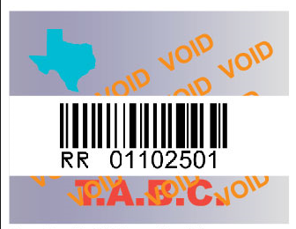
Product Integrity and Tax Stamps
Sec. 28.08. REFILLING CONTAINERS PROHIBITED. No holder of a mixed beverage permit may refill with any substance a container which contained distilled spirits on which the tax prescribed in Section 201.03 of this code has been paid.
Sec. 28.15. STAMPS. (a) A mixed beverage permittee may not possess or permit a person to possess on the premises distilled spirits in any container that does not bear a serially numbered identification stamp issued by the commission or other identification approved by the commission.
Sec. 28.09. INVALIDATION OF STAMP.
A holder of a mixed beverage permit or any
person employed by the holder who empties a
bottle con­taining distilled spirits on which the
tax prescribed in Section 201.03 of this code has
been paid, shall immediately after emptying the
bottle invalidate the iden­tification stamp on the
bottle in the manner prescribed by rule or
regulation of the commission or administration.
This document contains confidential information conveyed by fintech.net. Any dissemination, distribution, copying, or misrepresentation of the contents of this document is strictly prohibited.

Slide 14
Limitations for Advertising Prices
§45.105 Advertising
(a) Mixed Beverage Establishments
(2) Except as provided in this paragraph, the holder of any permit allowing the sale or service of mixed beverages may not advertise any price for an alcoholic beverage on any sign, billboard, marquee, or other display located on the licensed premises in such a manner that the price may be read by persons outside of the premises. It is an exception to the restriction in this paragraph if the holder of a food and beverage certificate places a menu on the exterior wall of the premises so that it can be read outside of the premises only by a pedestrian in close proximity to the menu.
This document contains confidential information conveyed by fintech.net. Any dissemination, distribution, copying, or misrepresentation of the contents of this document is strictly prohibited.

Slide 15
Offers to Help With Advertising
Sec. 102.07. PROHIBITED DEALINGS WITH RETAILER OR CONSUMER.
(a) Except as provided in Subsections (b), (d), and (g), no person who owns or has an interest in the business of a distiller, brewer, rectifier, wholesaler, class B wholesaler, winery, or wine bottler, nor the agent, servant, or employee of such a person, may:
(2) furnish, give, or lend any money, service, or thing of value to a retailer;
(6) pay or make an allowance to a retailer for a special advertising or distribution service
Sec. 108.05. ALLOWANCE FOR ADVERTISEMENT OR DISTRIBUTION.
No manufacturer or distributor, directly or indirectly, or through a subsidiary, affiliate, agent, employee, officer, director, or firm member, may pay or make an allowance to a retail dealer for an advertising or distribution service.
This document contains confidential information conveyed by fintech.net. Any dissemination, distribution, copying, or misrepresentation of the contents of this document is strictly prohibited.

Slide 16
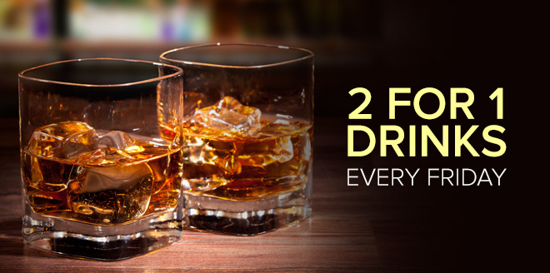
Drink Specials
§45.103 On-Premises Promotions
(c) Licensees and permittees authorized to sell
or serve alcoholic beverages for on-premises
consumption may not:
(1) serve, sell, or offer to serve or sell, two or more open containers of alcoholic beverages at a price less than the number of containers actually sold or served;
(2) increase the volume of alcohol contained in a drink without increasing proportionally the price thereof;
(3) serve or offer to serve more than one free alcoholic beverage to any identifiable segment of the population during the course of one business day. Licensees and permittees may, however, without prior advertising, give one free alcoholic beverage to individual consumers in celebration of birthdays, anniversaries or similar events;
This document contains confidential information conveyed by fintech.net. Any dissemination, distribution, copying, or misrepresentation of the contents of this document is strictly prohibited.

Slide 17
Drink Specials (… continued)
§45.103 On-Premises Promotions (… continued)
(c) Licensees and permittees authorized to sell or serve alcoholic beverages for on-premises consumption may not:
(4) sell, serve, or offer to sell or serve an undetermined quantity of alcoholic beverages for a fixed price or "all you can drink" basis;
(5) sell, serve, or offer to sell or serve, alcoholic beverages at a reduced price to those consumers paying a fixed "buy in" price;
(6) sell, serve, or offer to sell or serve, alcoholic beverages at a price contingent on the amount of alcoholic beverages consumed by an individual;
(7) reduce drink prices after 11:00 p.m.;
(8) sell, serve or offer to sell or serve more than two drinks to a single consumer at one time;
This document contains confidential information conveyed by fintech.net. Any dissemination, distribution, copying, or misrepresentation of the contents of this document is strictly prohibited.

Slide 18
Drink Specials (… continued)
§45.103 On-Premises Promotions (… continued)
(c) Licensees and permittees authorized to sell or serve alcoholic beverages for on-premises consumption may not:
(9) impose an entry fee, cover or door charge for the purpose of recovering financial losses incurred by the licensee or permittee because of reduced or low drink prices;
(11) engage in any practice, whether listed in this rule or not, that is reasonably calculated to induce consumers to drink alcoholic beverages to excess, or that would impair the ability of the licensee or permittee to monitor or control the consumption of alcoholic beverages by consumers.
Notwithstanding the above, licensees and permittees may 1) offer free or reduced price food or entertainment at any time, provided the offer is not based on the purchase of an alcoholic beverage and 2) include alcoholic beverages as part of a meal or hotel package.
This document contains confidential information conveyed by fintech.net. Any dissemination, distribution, copying, or misrepresentation of the contents of this document is strictly prohibited.

Slide 19
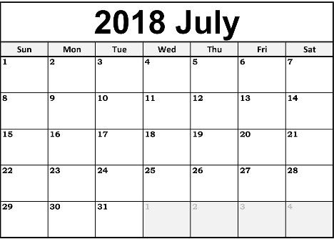
Payment Terms – Wine & Spirits
Sec. 102.32. SALE OF LIQUOR: CREDIT RESTRICTIONS.
No wholesale dealer may sell and no retailer may purchase liquor except for cash or on terms requiring payment by the retailer in accordance with Subsec­tion (c) of this section.
(c) On purchases made from the 1st through 15th day of a month, payment must be made on or before the 25th day of that month. On purchases made on the 16th through the last day of a month, payment must be made on or before the 10th day of the following month. An account is not delinquent if payment is received by the wholesale dealer not later than the fourth business day after the date payment is due under this subsection.
This document contains confidential information conveyed by fintech.net. Any dissemination, distribution, copying, or misrepresentation of the contents of this document is strictly prohibited.

Slide 20
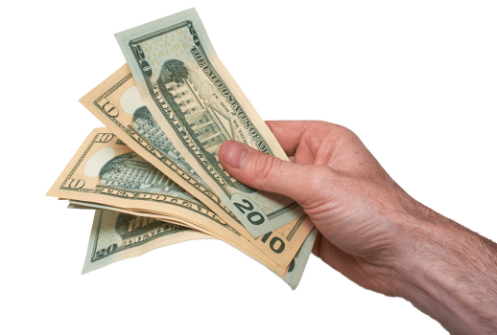
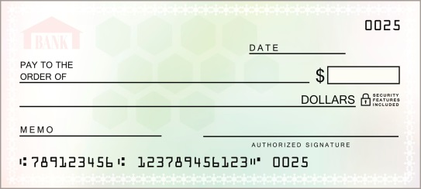
Payment Terms – Beer
Sec. 102.31. CASH PAYMENT REQUIRED. (a) This section applies to:
(1) the sale of beer or its containers or the original packages in which it is received, packaged, or contained by a distributor's licensee to a retail dealer's on-premise or off-premise licensee, a wine and beer retailer's permittee, or a wine and beer retailer's off-premise permittee; and
(2) the sale of malt beverages by a local distributor's permittee, or by any licensee authorized to sell those beverages for resale, to a mixed beverage or daily temporary mixed beverage permittee.
(b) No person directly or indirectly, or through a subsidiary, affiliate, agent, employee, officer, director, or firm member, may make a sale covered by this section except for cash on or before delivery to the purchaser.
This document contains confidential information conveyed by fintech.net. Any dissemination, distribution, copying, or misrepresentation of the contents of this document is strictly prohibited.

Slide 21
Alcohol Delivery to Consumers
Most package stores with local distributor permits can generally deliver alcohol within its city and/or county.
Mixed beverage permittees cannot deliver alcohol.
Most grocery and convenience stores can deliver beer (but not ale or wine) within the county.
Most restaurants with only a beer and wine permit can deliver beer (but not ale or wine) within the county.
Many restrictions and exceptions to these allowances and should be looked at on a case-by-case basis. (No delivery to dry areas, ordinances prohibiting the possession of alcohol in certain areas, etc.)
This document contains confidential information conveyed by fintech.net. Any dissemination, distribution, copying, or misrepresentation of the contents of this document is strictly prohibited.

Slide 22
Restrictions On Returning Alcohol
Retailer returns (to supplier) only allowed in certain instances:
In accordance with Sec. 104.05(d) alcoholic beverages may be replaced with like product, provided the product was damaged upon or prior to delivery or was unfit for consumption upon delivery, or is determined to be a consumer safety issued caused during the manufacturing process.
In accordance with Sec. 104.05(e) malt beverages that have not passed their expiration date may be replaced with identical product, as long as the amount does not exceed 25 cases of 24 12-ounce containers.
TABC policy also allows a refund, exchange, or credit for a delivery that was inconsistent with the order originally placed by the retailer, if done within 48 hours of the initial delivery of the inconsistent product.
Consumer returns (to retailer):
It is within the discretion of the retailer to grant refunds, credit, or exchanges to a customer that seeks to return alcohol.
This document contains confidential information conveyed by fintech.net. Any dissemination, distribution, copying, or misrepresentation of the contents of this document is strictly prohibited.

Slide 23
Recordkeeping
Rule 45.121
(c) Invoices.
(1) The Seller's copy of the invoice must be signed by the Retailer to verify receipt of alcoholic beverages and accuracy of invoice.
(2) The Seller and Retailer must retain invoices in compliance with the requirements of §206.01 of the Code.
(3) Invoices may be created, signed and retained in an electronic or internet based inventory system, and may be retained on or off the licensed premise, as long as the records can be accessed from the licensed premises and made available to the commission during normal business hours.
Sec. 206.01. RECORDS.
(a) A permittee who distills, rectifies, manufacturers, or receives any liquor shall make and keep a record of each day's production or receipt of liquor and the amount of tax stamps purchased by the permittee. All required records shall be kept available for inspection by the commission or its authorized representatives for at least four years.
This document contains confidential information conveyed by fintech.net. Any dissemination, distribution, copying, or misrepresentation of the contents of this document is strictly prohibited.

Slide 24
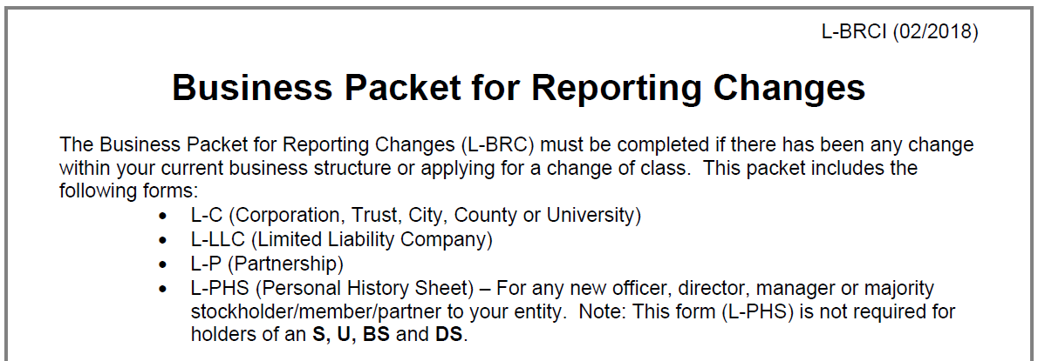
Reporting Requirements
Changes to business structure
A business packet for reporting changes (Form L-BRC) is generally required to filed with TABC if there has been any change in the TABC disclosed business structure. Generally due within 30 days of closing but can be 10 days in some instances.
Changes in Officers/Directors/Managers
New officers, directors, managers and majority owners may be required to submit personal history sheets (Form L-PHS) and may require submission of criminal background checks.
Pre-change notice requirements to TABC may be required depending upon the change.
This document contains confidential information conveyed by fintech.net. Any dissemination, distribution, copying, or misrepresentation of the contents of this document is strictly prohibited.

Slide 25
Licensing – Considerations for New Locations
Wet/Dry/Damp Areas
Distance to Schools/Churches/Public Hospitals
Zoning Regulations
Conditional/Special Use Permits
Residences within 300 feet
Protests
Patio Usage
Seating
Food Offerings
This document contains confidential information conveyed by fintech.net. Any dissemination, distribution, copying, or misrepresentation of the contents of this document is strictly prohibited.

Slide 26
Safe Harbor (“Get Out of Jail Free” Card)
Sec. 106.14. ACTIONS OF EMPLOYEE
The actions of an employee (specifically for sale of alcoholic beverage to an intoxicated patron and/or sale to minor) shall not be attributable to the employer if:
(1) the employer requires its employees to attend a commission-approved seller training program;
(2) the employee has actually attended such a training program; and
the employer has not directly or indirectly encouraged the employee to violate such law.
* All staff that serves, sells or manages those that serve or sell alcoholic beverages must be TABC certified at all times, and all employees must have read and signed responsible alcohol service policies that are then kept for at least a year after employee termination.
This document contains confidential information conveyed by fintech.net. Any dissemination, distribution, copying, or misrepresentation of the contents of this document is strictly prohibited.

Slide 27
Other Things to Consider
“Things of Value”/gifts from suppliers and wholesalers
Internal and external signs
Percentage of alcohol sales
Food products with alcohol added
Creating infused drinks
Tap handles and draft lines
Server training
Sponsorships
Special Event Permits
On-site tastings and samples
Transferring product between stores (if multiple locations owned)
Upcoming legislative proposals
This document contains confidential information conveyed by fintech.net. Any dissemination, distribution, copying, or misrepresentation of the contents of this document is strictly prohibited.

Slide 28
Thank you!
Dewey Brackin / Partner
Catherine Chamblee /Associate
Marcus Schwartz / Associate

